Slide 1
FAccT Machine Learning
Dr. Bharathi R
CSE Department

Slide 2
SE ZG568/SS ZG568 , Applied Machine Learning
Lecture No.10.3- Module 10

Slide 3
In This Session
Fairness
Accountability
Transparency

Slide 4

Fairness in Machine Learning
What to do to ensure gender and ethnic fairness in ML models?

Slide 5

Accountability
Who takes the responsibilities for failed ML models?

Slide 6

Transparency
What to do to make ML models transparent and comply with regulations?

Slide 7

Privacy Issues
How to protect user privacies when exposing data to ML models?

Slide 8
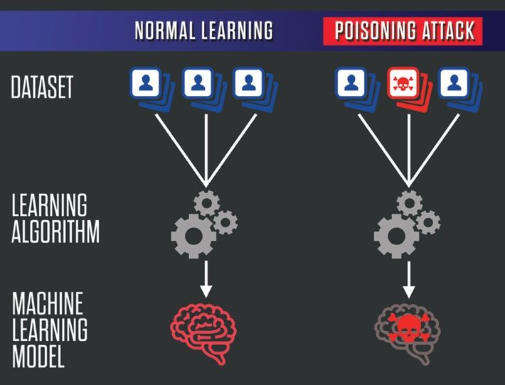
Security Issues
How do we defend ML models against data poisoning?

Slide 9
FAccT Overview
Psychology Social Science Public Policy
Fairness
Accountability
Statistics
Theory
Transparency
Machine Learning
Privacy
Robustness

Slide 10
Thank You!
In our next session: Fairness and Bias

Slide 11
Fairness and Bias
Dr. Bharathi R
CSE Department

Slide 12
SE ZG568/SS ZG568 , Applied Machine Learning
Lecture No.10.2- Module 10

Slide 13
In This Session
Sources of Bias
Real World Examples
Sensitive Features
Fairness Criteria
Fairness Preserving Regularization

Slide 14
Fairness
What is Fairness?
The absence of bias towards an individual or a group (Mehrabi et al, 2019)
Can ML Models Discriminate?
Aren't machines just follow human's instructions?
ML models approximate patterns in the data
Learns/Amplifies biases at the same time

Slide 15
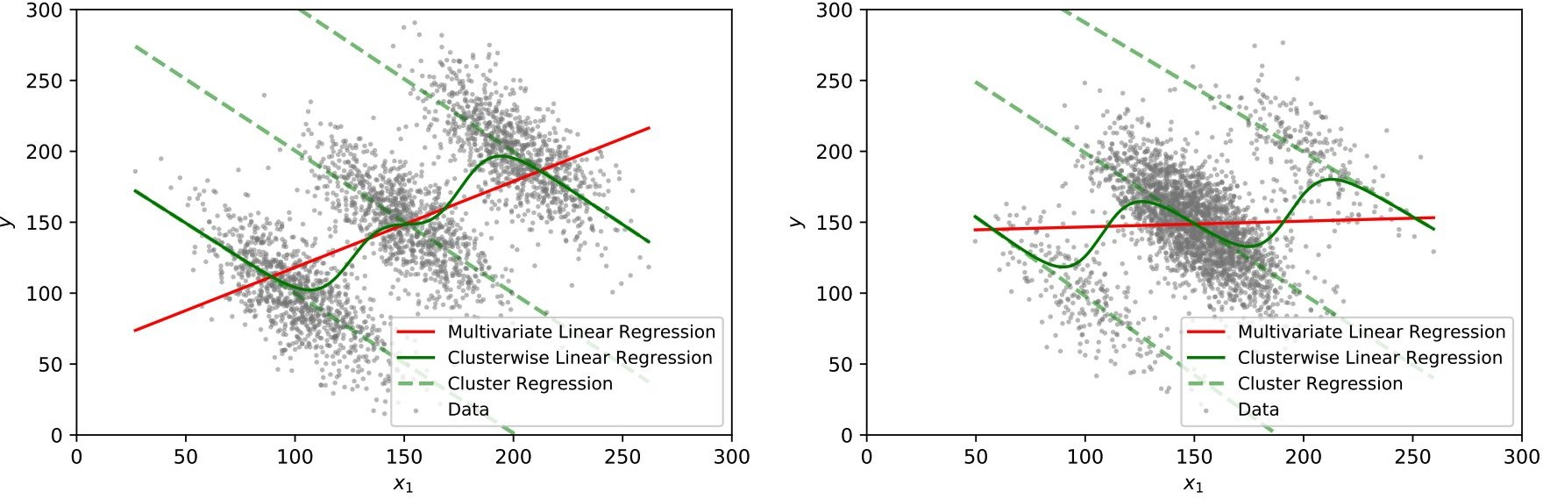
Model Sensitivity to Data
red - biased regression
dashed green - regression for each subgroup solid green - unbiased regression

Slide 16
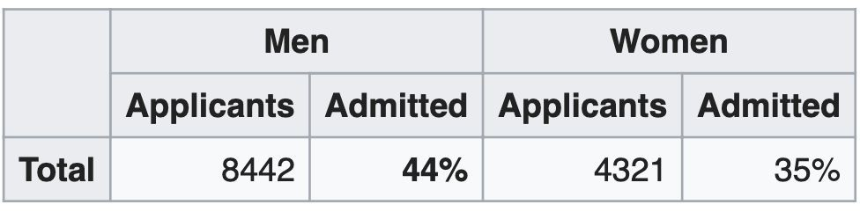
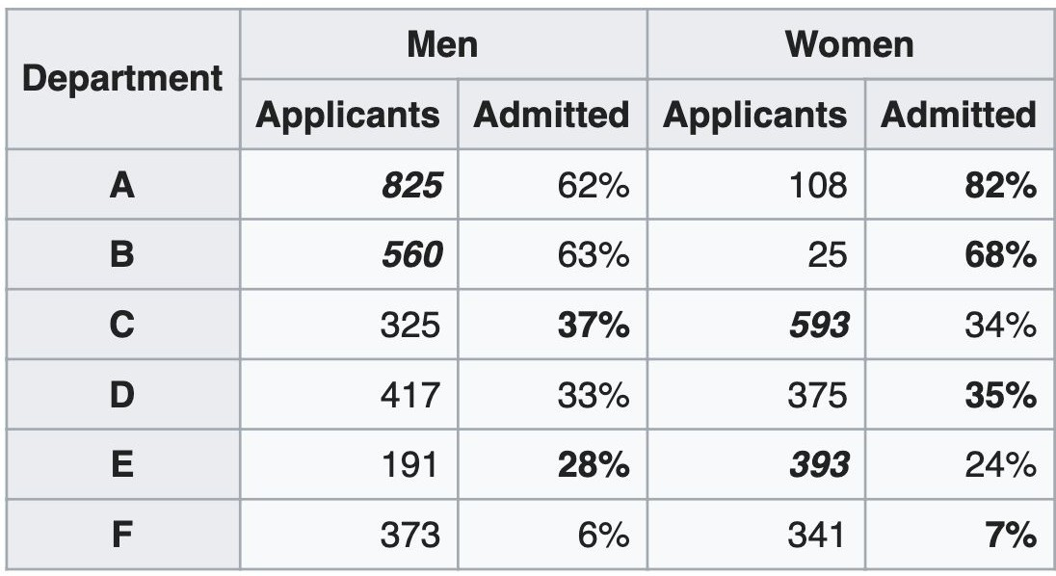
Simpson’s Paradox
https://en.wikipedia.org/wiki/Simpson%27s_paradox

Slide 17
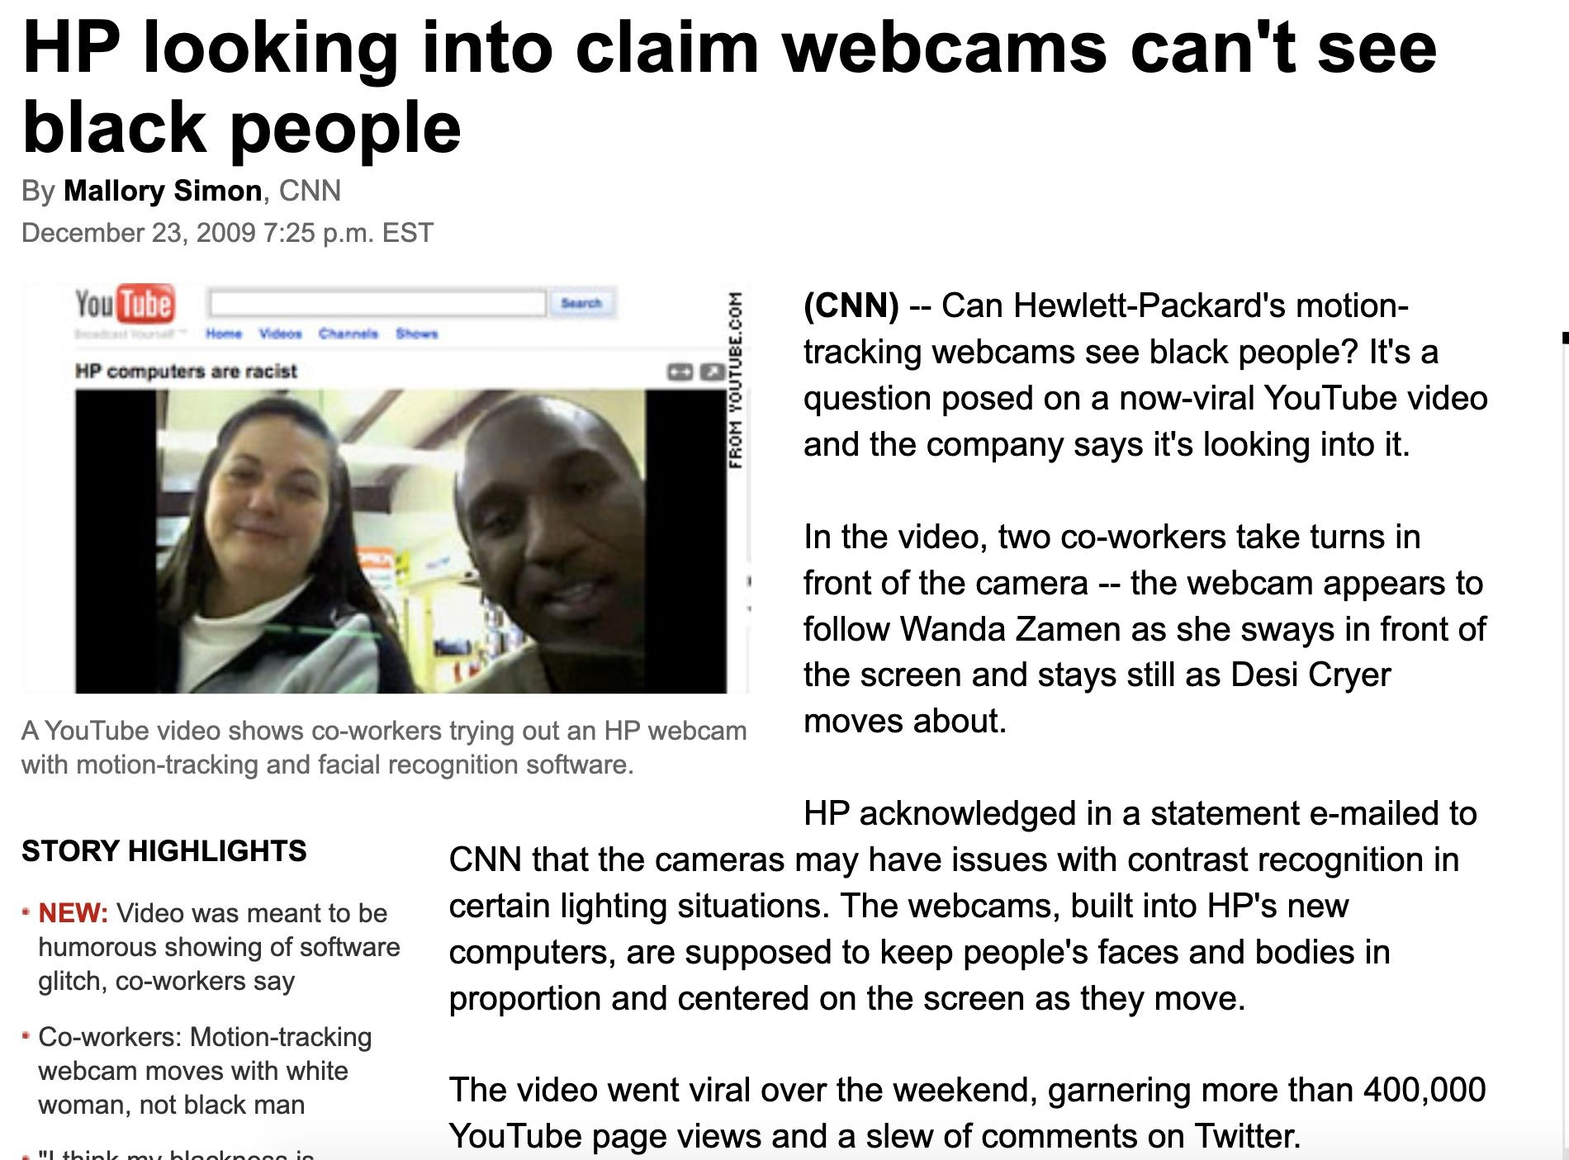
Real World Example

Slide 18
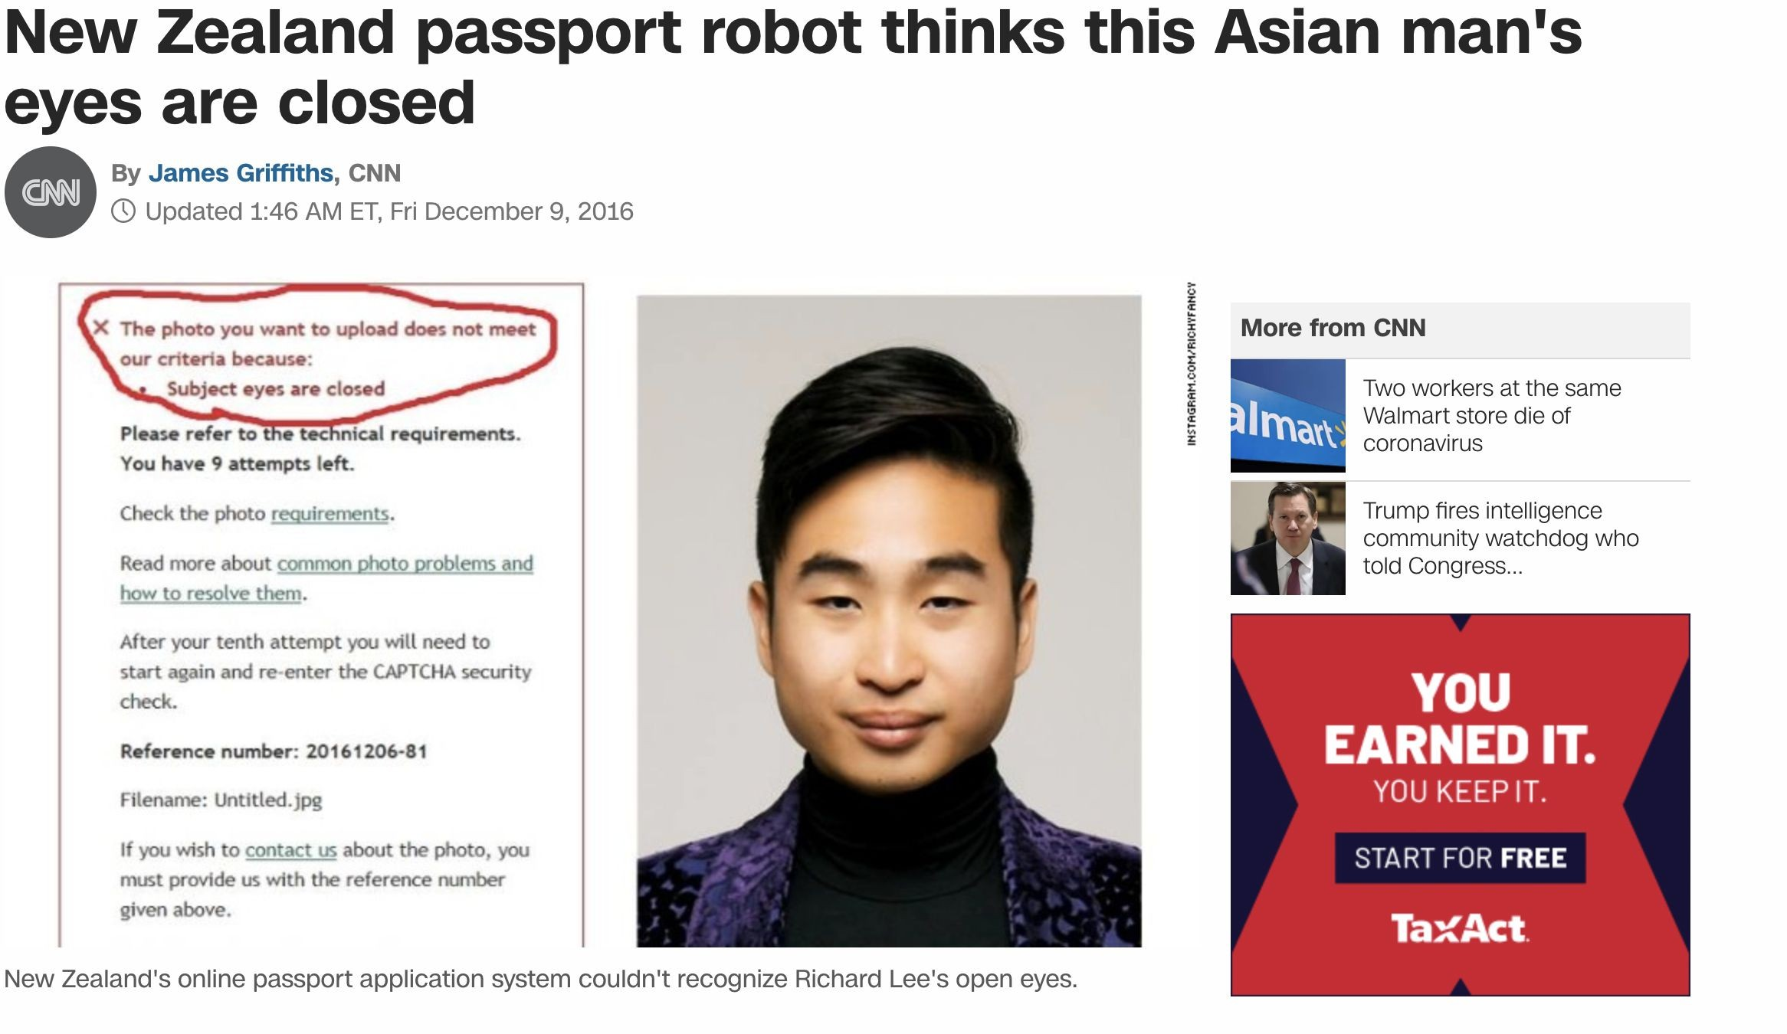
Real World Example

Slide 19
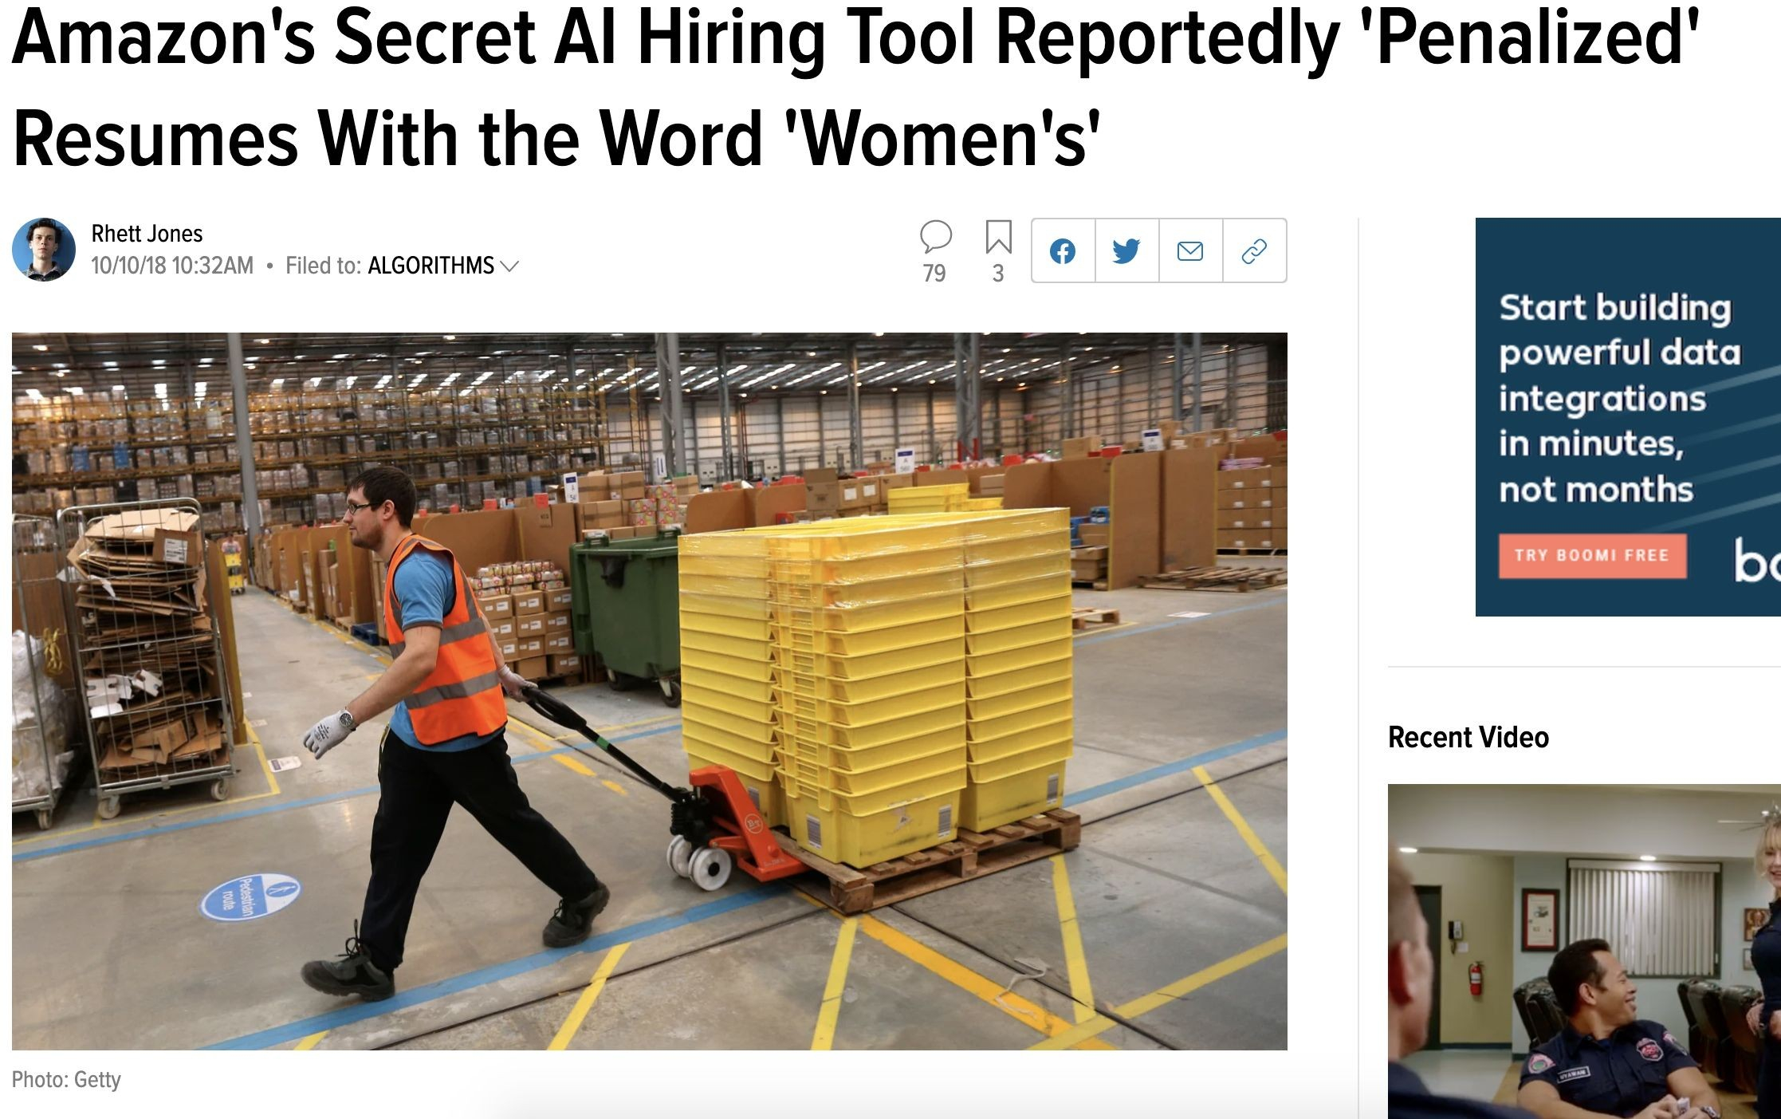
Real World Example

Slide 20
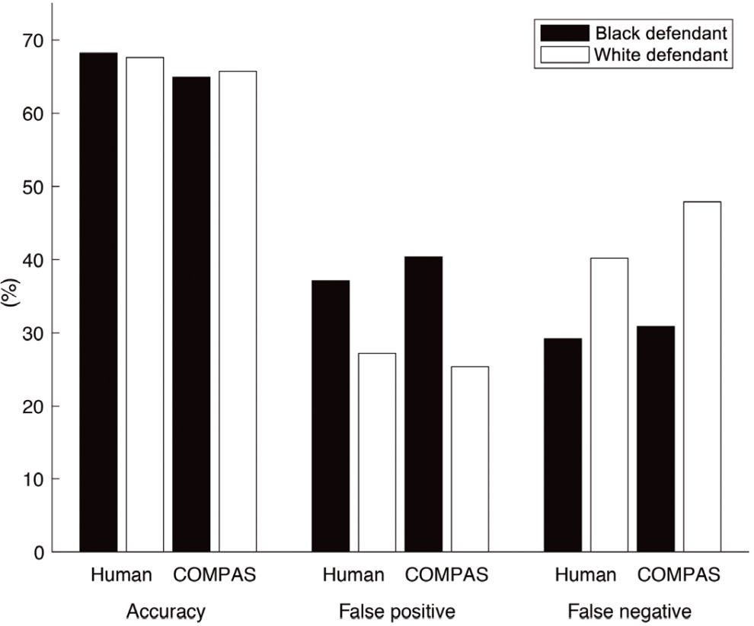
Algorithmic Bias
Commercial risk assessment software known as COMPAS
Assess more than 1 million offenders since 2000
Predicts a defendant’s risk of committing a misdemeanor or felony
137 features
Dressel et al, 2018

Slide 21
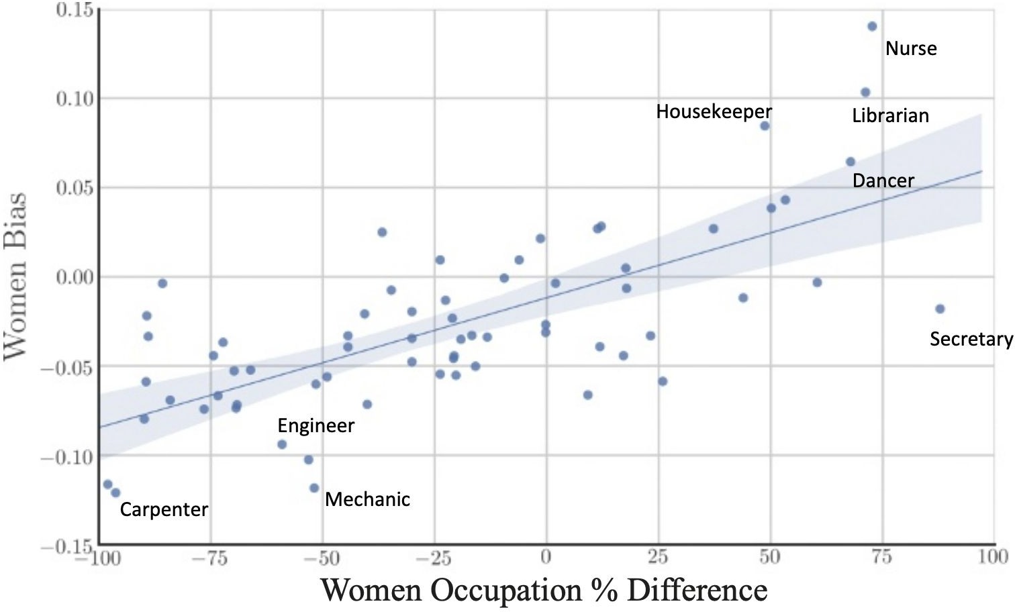
Bias in Historical Data
Gard et al, 2018

Slide 22
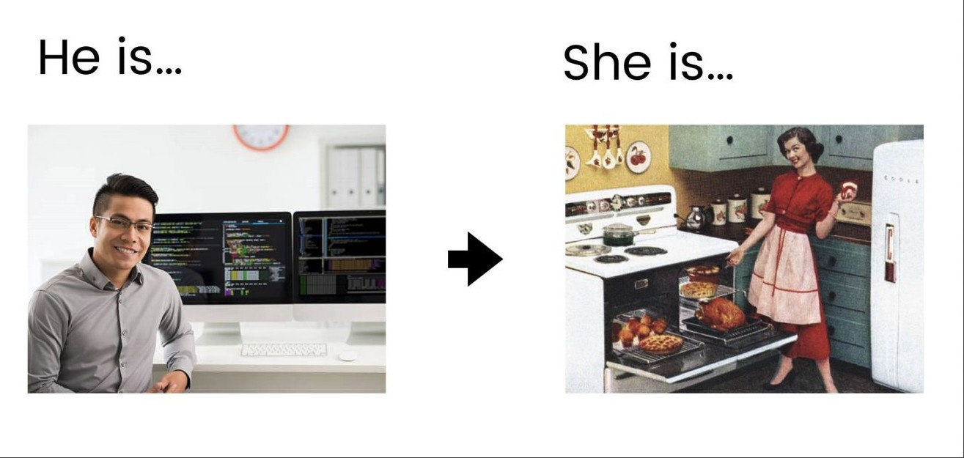
Biases in Word Embedding (Gard et al, 2018 )

Slide 23
Fairness Through Unawareness
A ML Algorithm Achieves Fair Through Unawareness If
None of the sensitive features are directly used in the model
Race and Ethnicity | Skills | Years of Exp | Hired?
Hispanic | Javascript | 1 | no
Hispanic | C++ | 5 | yes
White | Java | 2 | yes
White | C++ | 3 | yes
Fair ML Model
Training

Slide 24
Indirect Evidence
Sensitive Features May Still Be Used
Inferred from indirect evidence
Race and Ethnicity | Skills | Years of Exp | Often Goes to Mexican Markets | Hiring Decision | Training
Hispanic | Javascript | 1 | yes | no
Hispanic | C++ | 5 | yes | yes
White | Java | 2 | no | yes
White | C++ | 3 | no | yes
Discriminatory ML Model

Slide 25
Interpretability and Accountability
Dr. Bharathi R
CSE Department

Slide 26
SE ZG568/SS ZG568 , Applied Machine Learning
Lecture No.8.1- Module 8

Slide 27
In This Segment
ML Interpretability
Intrinsically Interpretable Models
Simple interpretable models
Intrinsically interpretable techniques for deep learning
Interpretability Concepts
Intrinsic and post hoc methods
model-specific and model-agnostic methods
Local and global interpretable methods
Interpretability and performance trade-offs

Slide 28
Reasons for ML Interpretability
Our society has been shifted to rely on AI more than ever
autonomous vehicles
Security
Finance
many others
Who will benefit from ML Interpretability?
End Users: enhance trust, understand the consequences of the decisions, e.g., privacy, fairness.
Regulatory Agencies: compliance, audits, and accountability.
Model Designers: diagnose model performance

Slide 29
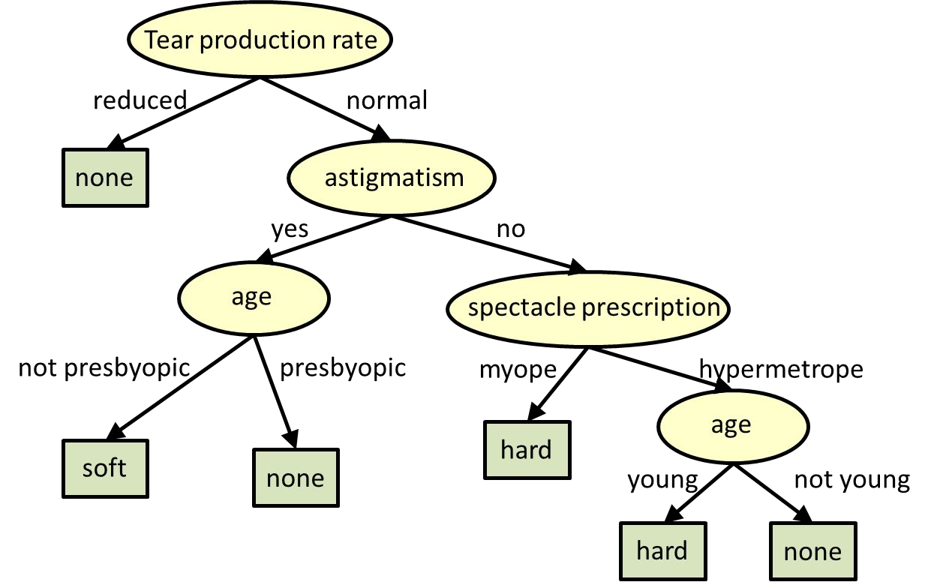
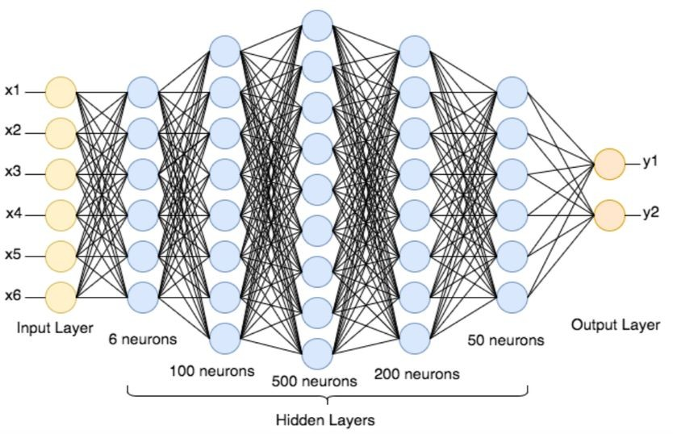
Machine Learning Interpretability
ML interpretability allows one to examine model's basis in its decision making process
A neural network which is usually considered a black-box model.
An interpretable tree model to find out the kind of contact lens a person may wear

Slide 30
Intrinsically interpretable models
Models that are interpretable by design
No post-processing steps are needed to achieve interpretable.

Slide 31
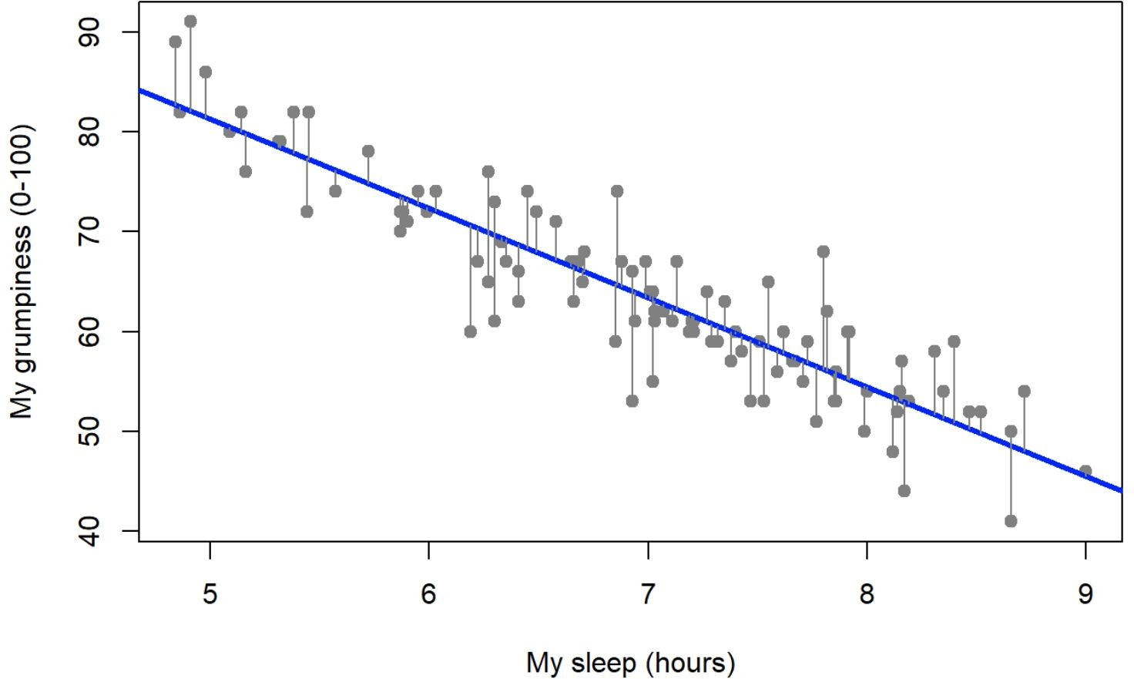
Linear Regression
interpretable components

Slide 32
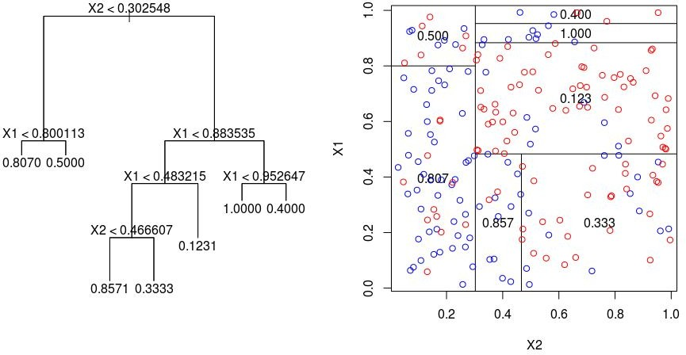
Decision Trees

Slide 33
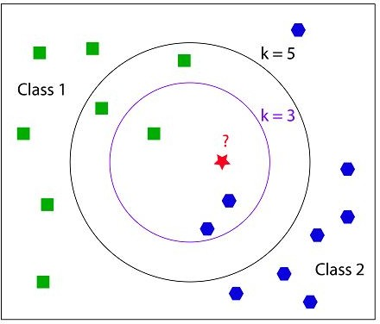
K-Nearest Neighbors

Slide 34
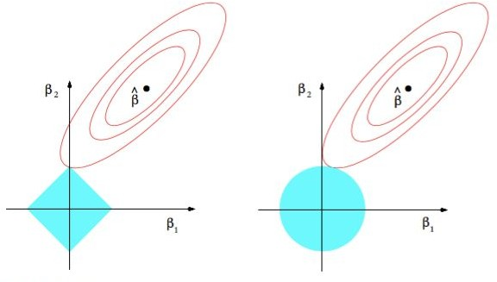
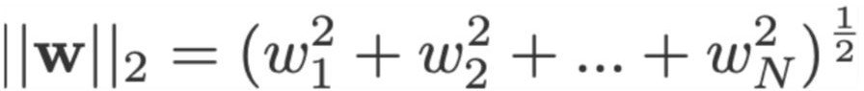
Sparsity
Controls the sparsity of model parameters when learning a model
Popular choices
L1 regularization
L2 regularization

Slide 35
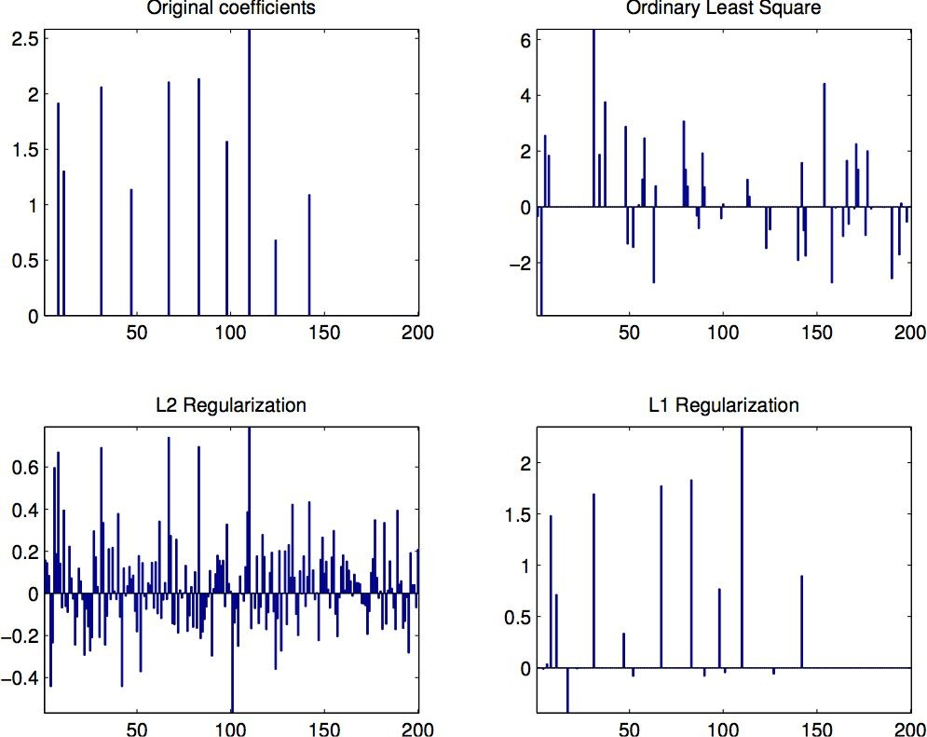
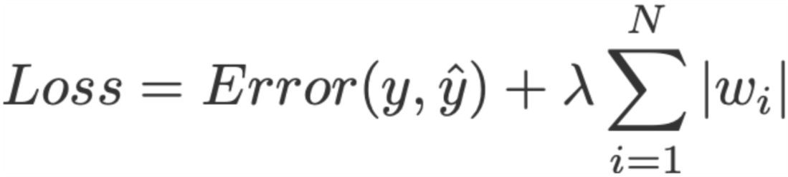
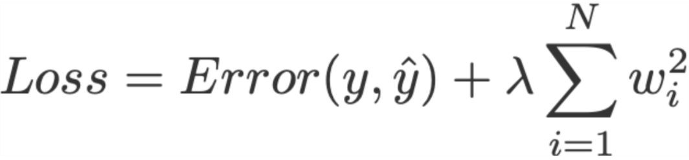
Sparsity for Interpretable Linear Regression
In the case of linear regression
○
Linear regression with L1 regularization
Linear Regression with L2 regularization

Slide 36
Intrinsic and Post Hoc Interpretability
Intrinsically interpretable models
Interpretable is achieved by model design
ML models are explainable by itself
Explainability is often achieved as a byproduct of model training
Interpretable Architecture
train
Interpretable Model
explain
Post Hoc/Model-specific methods
Explainability is often achieved after the model is trained
Interpretable is achieved using external methods
Black-box Architecture
train
Black-box Model
post-hoc methods
explain

Slide 37
Post Hoc Interpretability
One of the way to achieve Post Hoc Interpretability is to deploy a local proxy model
Black Box Deep Learning Model | match behavior | Local Interpretable Model
Explain

Slide 38
Model Specific and Model Agnostic Methods
Model Specific Methods
Techniques that can be used for a specific architecture
Usually preferable when you have the ability to design your own model
Model specific techniques might compromise the performance of your model
Requires training the model using a dataset
Intrinsic methods are by definition model specific
Model-agnostic Methods
Techniques that can be used across many black box models
Model-agnostic methods will not affect the performance of your model
Do not require training the model
Post hoc methods are usually model-agnostic

Slide 39
Global and Local Interpretability
Global Interpretability
Explains the entire ML model at once from input to prediction
1) Holistic Model Interpretability
2) Modular Level Interpretability
e.g., Decision Trees, Linear regression
Local Interpretability
Explain how predictions change for when input changes
1) For a single prediction
2) for a group of predictions

Slide 40
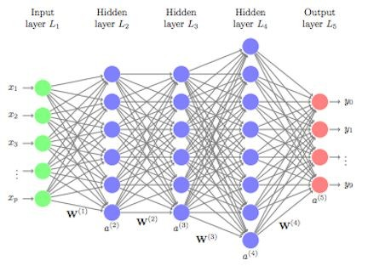
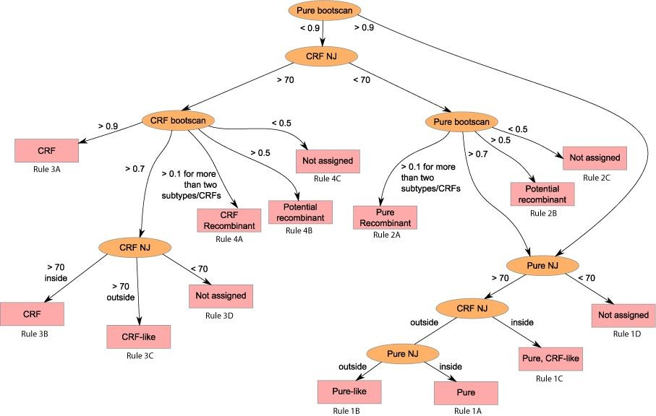
Global Interpretability
globally interpretable proxy

Slide 41

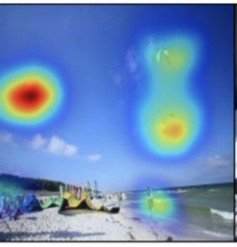
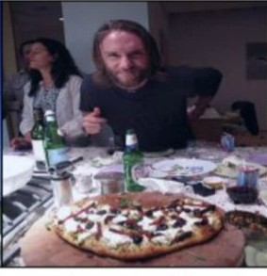
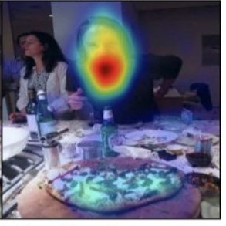
Local Interpretability
model interpretation
x
black-box model f
exp(x, f)
model interpretation
x
exp(x, f)

Slide 42
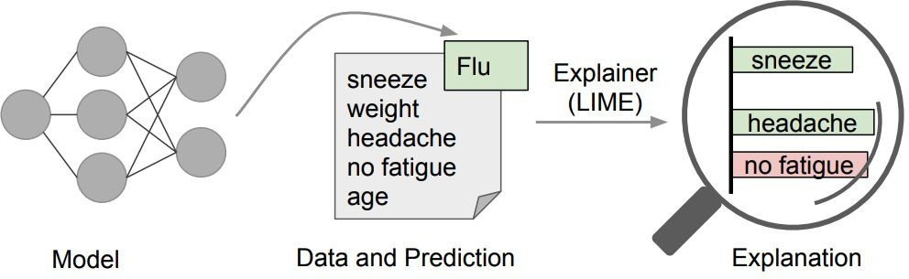
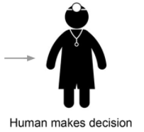
Local Interpretable Model-Agnostic Explanations (LIME)
LIME “explainer” that highlights the symptoms that are most important to the model or in other words rationale behind the model.
Perturb the input by changing components that make sense to humans (e.g., attributes of a record, or words or parts of an image), even if the model is using much more complicated components, and see how the prediction changes
Generate an explanation by approximating the underlying model by an interpretable one (such as a linear model with only a few non-zero coefficients), learned on perturbations of the original instance

Slide 43
Local Interpretable Model-Agnostic Explanations (LIME)
The key intuition behind LIME is that it is much easier to approximate a black-box model by a simple model locally (in the neighborhood of the prediction we want to explain), as opposed to trying to approximate a model globally.
the three highlighted symptoms may be a faithful approximation of the black-box model for patients who look like the one being inspected, but they probably do not represent how the model behaves for all patients.
In the case of an image (or text), perturbation may involve hiding parts of the image (or removing some words) and then weighting the perturbed images by their similarity to the instance we want to explain.

Slide 44
Shapley Additive Explanations (SHAP)
Inspired by cooperative game theory
Shapley value for each variable (payout) finds the correct weight such that the sum of all Shapley values is the difference between the predictions and average value of the model.
Shapley values correspond to the contribution of each feature towards pushing the prediction away from the expected value of predictions.
To get the importance of feature X{i}:
Get all subsets of features S that do not contain X{i}
Compute effect on our predictions of adding X{i} to all those subsets
Aggregate all contributions to compute the marginal contribution of the feature
Now, for these subsets, for the removed or left out feature, SHAP just replaces it with the average value of the feature and generates the predictions.

Slide 45

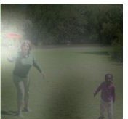
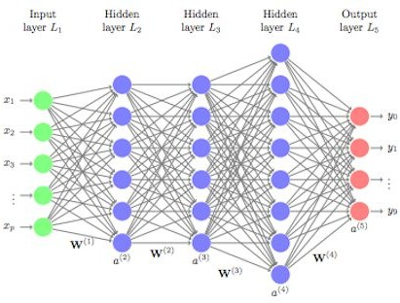

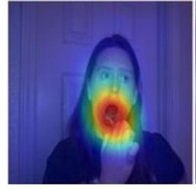
The Big Picture
Globally Interpretable
Locally Interpretable
Intrinsic
input
model
Output
black-box model
Post Hoc
interpretation
Feature

Slide 46
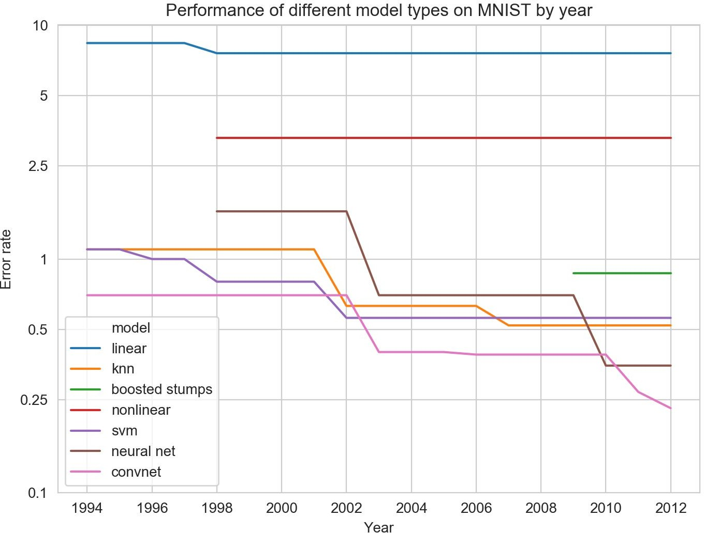
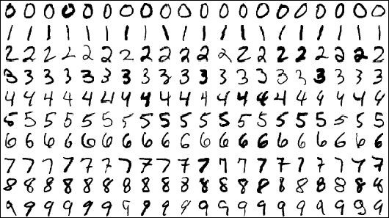

Interpretability and Performance Trade-offs
highly performed models tend to be less interpretable.
Can powerful models with complex structures be interpretable at the same time?
more interpretable
less interpretable
MNIST Dataset
http://yann.lecun.com/exdb/mnist/ https://soph.info/2018/11/08/mnist-history/

Slide 47
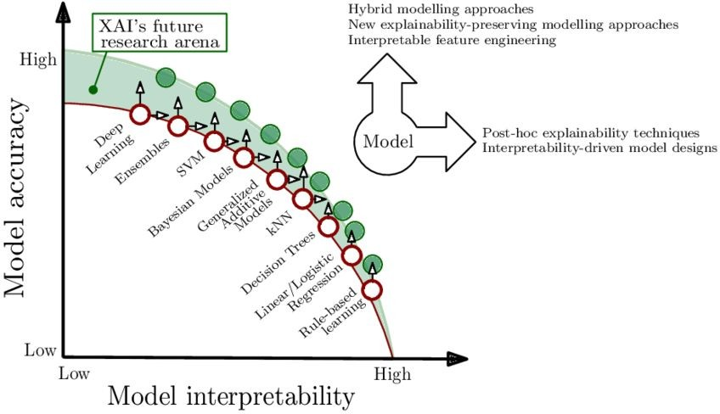
Interpretability and Performance Trade-offs
Arrieta et al., 2019

Slide 48
Thank You!

